Slide 1

Wild Wood Apartments
Database Management System
By James Osibogun

Slide 2
Summary of Problem
The Wild Wood apartment project is to build a database system based on SQL that helps the managers keep up with paperwork.
The paperwork files are primarily late fees from the tenants.
It is hard for managers to keep track of and store information. The backlog reports need more time to fill out or adequately document..

Slide 3
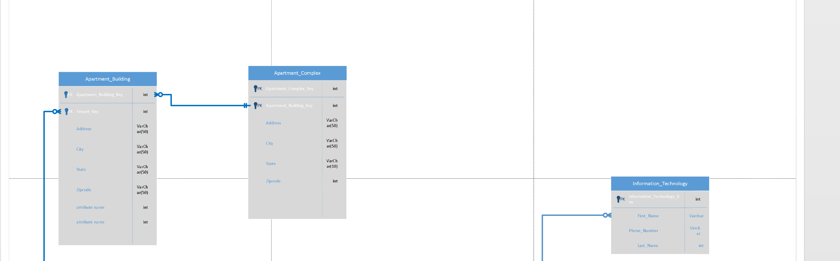
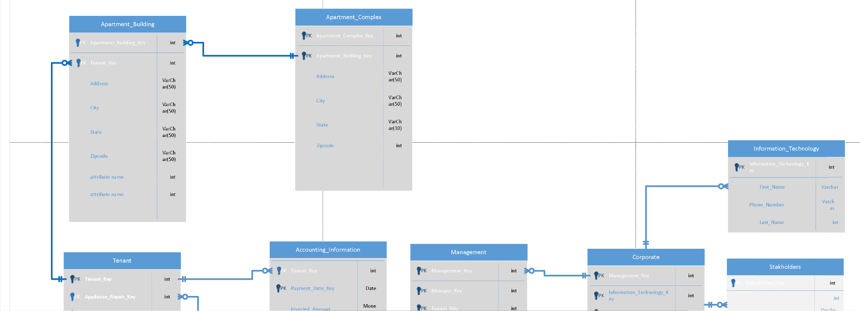
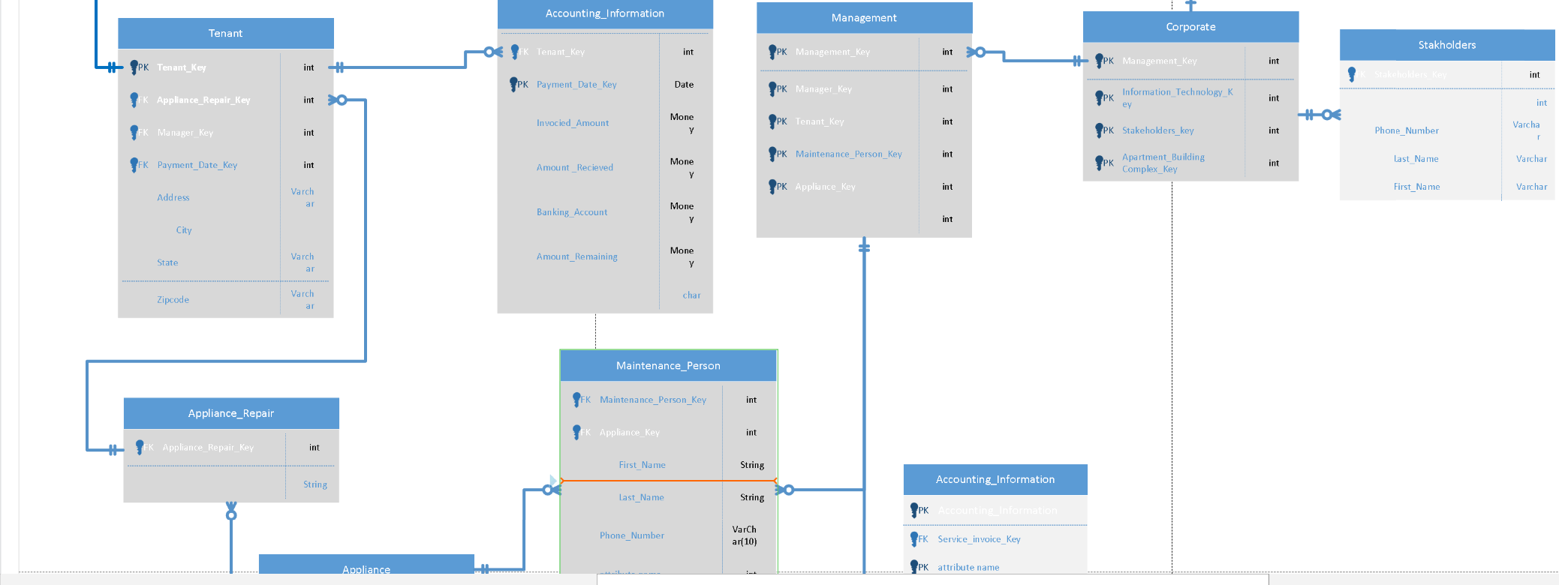
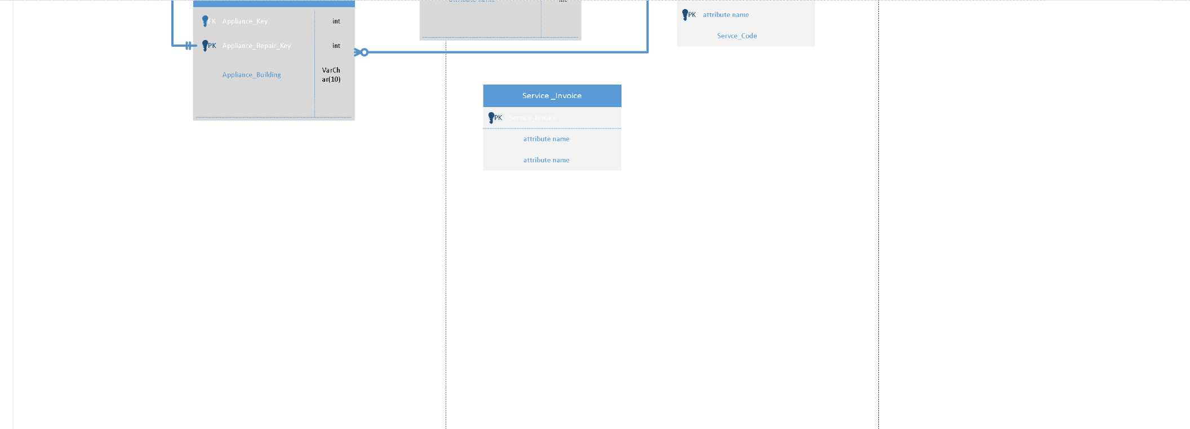
Database Design

Slide 4

Database Design
Tenant
Manager
Maintenance
Management
Account Information
Appliance Repair
Apartment Complex
Apartment Building

Slide 5

Recommendations for DBMS: SQL Server Manager
Recommendation and Defense of DBMS Products
Data processing: It allows us to process the data stores in order to generate the desired output. The data could be computed using SQL server.
High storage: We can store a large amount of data in the SQL server. Due to its high storage capacity, it is considered best while data storing in organizations.
Integration with front-end: It could also be integrated with the frontend application to offer the mechanism of dynamically data change. It is very frequently used in integration with web applications.
Easy to connect with.Net: As SQL server and.Net framework both belong to Microsoft; both are very easy to be connected. It works very fine or smooth when merged with an application developed on .Net.
Data processing: It allows us to process the data stores in order to generate the desired output. The data could be computed using SQL server.
High storage: We can store a large amount of data in the SQL server. Due to its high storage capacity, it is considered best while data storing in organizations.
Integration with front-end: It could also be integrated with the frontend application to offer the mechanism of dynamically data change. It is very frequently used in integration with web applications.
Easy to connect with .Net: As SQL server and .Net framework both belong to Microsoft; both are very easy to be connected. It works very fine or smooth when merged with an application developed on .Net.

Slide 6

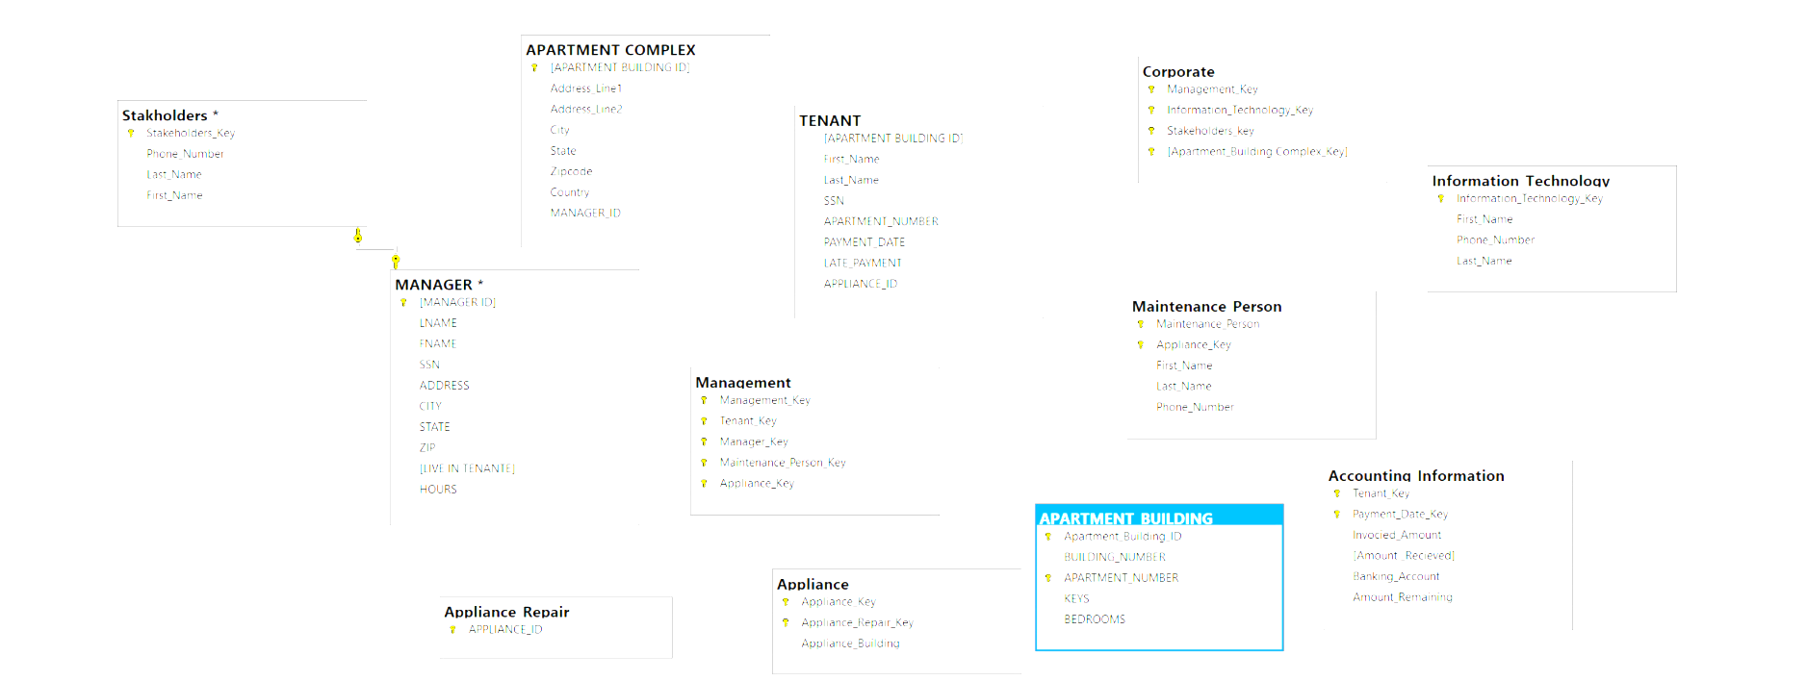
Enterprise Data Model

Slide 7

Security Management Plan
Why is it important?
It must have a Compromised intellectual property
It can Damage to brand reputation
Business continuity (or lack thereof)(Security Breach)
Fines or penalties for non-compliance(if and when caught)
Costs of repairing breaches and notifying customers
Insider Threats
A malicious insider who intends to do harm
A negligent insider who makes errors that make the database vulnerable to attack
An infiltrator—an outsider who somehow obtains credentials via a scheme such as phishing or by gaining access to the credential database itself

Slide 8

Security Management Plan: Cont’d
Other threats:
Human error
Exploitation of database software vulnerabilities
SQL/NoSQL injection attacks
Buffer overflow exploitation
Malware
Attacks on backups
Denial of service (DoS/DDoS) attacks

Slide 9

Best practice:
Physical security:
Administrative and network access control
End user account/device security
Encryption
Database software security
Application/web server security
Backup security
Auditing
s

Slide 10

References:

Slide 11

Kolonko, K(February, 2018).Performance comparison of the most popular relational and non-relational database management systems. Retrieved on April 2, 2023 from https://www.diva-portal.org/smash/get/diva2:1199667/FULLTEXT02.pdf
Netwrix(n.d)Top 14 Data Security Best Practices. Retrieve 0n April 2, 2023, from
https://www.netwrix.com/data_security_best_practices.html#:~:text=Use%20data%20encryption.,devices%20or%20over%20the%20network.
Conger, S. (2014). Hands-On Database, 2nd Edition. [MBS Direct]. Retrieved from https://mbsdirect.vitalsource.com/#/books/9780133927078/
UKEssays. (November 2018). Database Management: Law, Ethics and Security. Retrieved from https://us.ukessays.com/essays/computer-science/database-management-law-ethics-9552.php?vref=1
Database Management Fandom(n.d.) Database Management. Retrieved on March 28, 2023, from https://databasemanagement.fandom.com/wiki/Business_Rules
Microsoft (February 23, 2023). Business Rules (Master Data Services). Retrieved on March 24, 2023, from https://learn.microsoft.com/en-us/sql/master-data-services/business-rules-master-data-services?view=sql-server-ver16
Raipurkar , A (2012). Business Rules in DBMS. Retrieved on March 28, 2023, from https://www.proquest.com/docview/1443724655
Erp-information (n.d). Microsoft SQL Server Overview (Features and Pricing). Retrieved on March 5, 2023, from https://www.erp-information.com/microsoft-sql-server.
Pijacek, R (Jan 17, 2019). Microsoft SQL Server Pros and Cons. Retrieved on March 7, 2023, from
https://learnsql.com/blog/microsoft-sql-server-pros-and-cons/
Statista (n.d). The most popular database management system worldwide 2023. Retrieved on March 7, 2023 from https://www.statista.com/statistics/809750/worldwide-popularity-ranking-database-management-systems/#:~:text=As%20of%20February%202023%2C%20the,rounded%20out%20the%20top%20three.
LearnMicrosoft(n.d). SQL Server 2022: Hardware and software requirements. Retrieved on March 10, 2023, from https://learn.microsoft.com/en-us/sql/sql-server/install/hardware-and-software-requirements-for-installing-sql-server-2022?view=sql-server-ver16

